Slide 1
SPRING MVC OVERVIEW
Date

Slide 2
What is Spring MVC?
•
Framework for building web applications in Java
•
Based on Model-View-Controller design pattern
•
Leverages features of the Core Spring Framework (IoC, DI)

Slide 3




Model-View-Controller (MVC)
Front Controller
Model
Web Browser
Controller
Model
View Template

Slide 4
Spring MVC Benefits
•
The Spring way of building web app UIs in Java
•
Leverage a set of reusable UI components
•
Help manage application state for web requests
•
Process form data: validation, conversion etc
•
Flexible configuration for the view layer

Slide 5
Spring MVC Behind the Scenes
Date

Slide 6


Components of a Spring MVC Application
Web Pages
•
A set of web pages to layout UI components
•
A collection of Spring beans (controllers, services, etc…)
Beans
•
Spring configuration (XML, Annotations or Java)
Spring Configuration

Slide 7
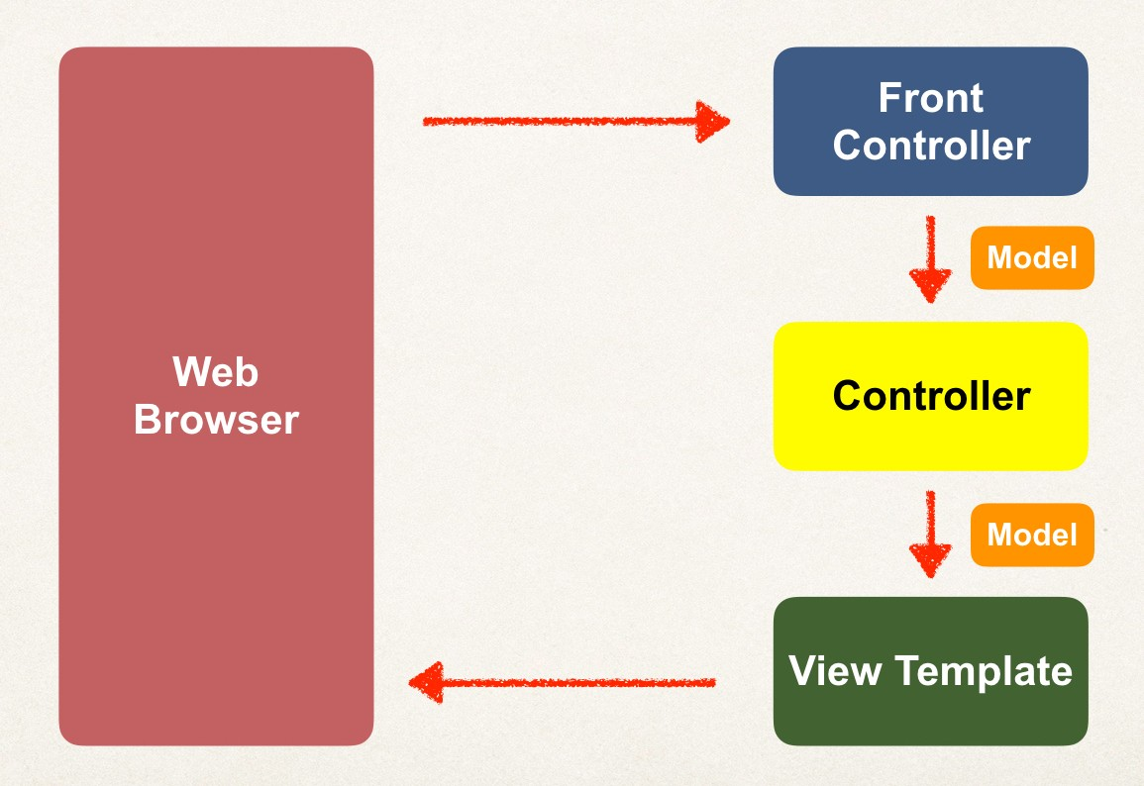

How Spring MVC Works Behind the Scenes

Slide 8
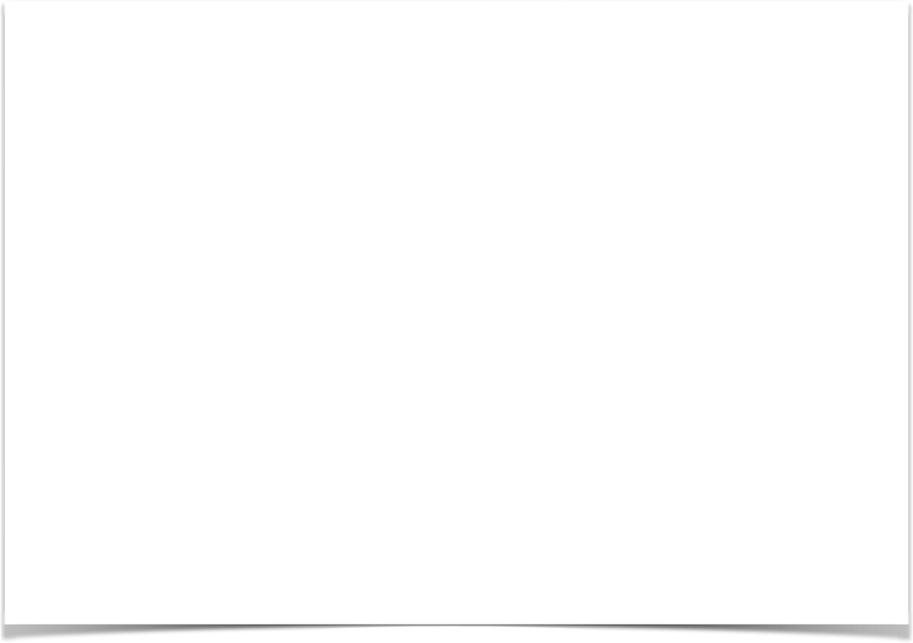
Spring MVC Front Controller
•
Front controller known as DispatcherServlet
Part of the Spring Framework
Already developed by Spring Dev Team
•
You will create
Model objects (orange)
View templates (dark green)
Controller classes (yellow)

Slide 9

Controller
Code created by developer
•
Contains your business logic
Handle the request
Store/retrieve data (db, web service…)
Place data in model
•
Send to appropriate view template

Slide 10
Model
•
Model: contains your data
•
Store/retrieve data via backend systems
•
database, web service, etc…
•
Use a Spring bean if you like
•
Place your data in the model
•
Data can be any Java object/collection

Slide 11
View Template
Spring MVC is flexible
Supports many view templates
•
Most common is JSP + JSTL
•
Developer creates a page
Displays data
JSP: Java Server Pages
JSTL: JSP Standard Tag Library

Slide 12
Dev Environment Setup

Slide 13

Dev Environment Check Point
At this point
Apache Tomcat
Eclipse (Java EE version) Connected Eclipse to Tomcat

Slide 14

Tomcat Version
New version of Tomcat 10 was released to support Jakarta EE 9
Renamed packages: javax.* to jakarta.*
This is a breaking change for Java EE apps
Spring 5 currently does not support the new package renaming Jakarta EE 9
As a result, Spring 5 does not currently work on Tomcat 10
Use Tomcat 9 for your Spring 5 apps
Spring Team is aware of this issue. You can track the status https://github.com/spring-projects/spring-framework/issues/25354

Slide 15
SPRING MVC CONFIGURATION
Date

Slide 16
Model-View-Controller (MVC)

Slide 17
Spring MVC Configuration Process - Part 1
Add configurations to file: WEB-INF/web.xml
Configure Spring MVC Dispatcher Servlet
Set up URL mappings to Spring MVC Dispatcher Servlet
Step-By-Step

Slide 18
Spring MVC Configuration Process - Part 2
Add configurations to file: WEB-INF/spring-mvc-demo-servlet.xml
Add support for Spring component scanning
Add support for conversion, formatting and validation
Configure Spring MVC View Resolver
Step-By-Step

Slide 19

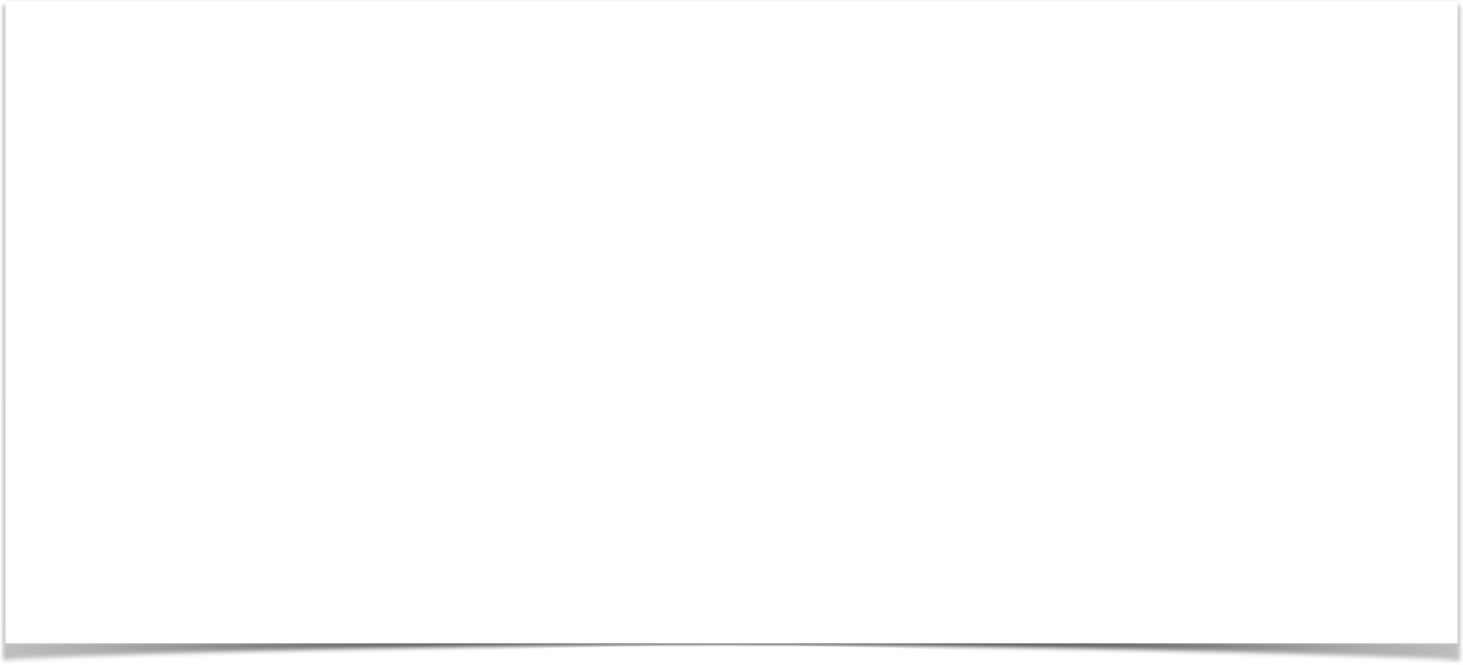
Step 1: Configure Spring DispatcherServlet
File: web.xml
<web-app>
<servlet>
<servlet-name>dispatcher</servlet-name>
<servlet-class>org.springframework.web.servlet.DispatcherServlet</servlet-class>
<init-param>
<param-name>contextConfigLocation</param-name>
<param-value>/WEB-INF/spring-mvc-demo-servlet.xml</param-value>
</init-param>
<load-on-startup>1</load-on-startup>
</servlet>
</web-app>

Slide 20
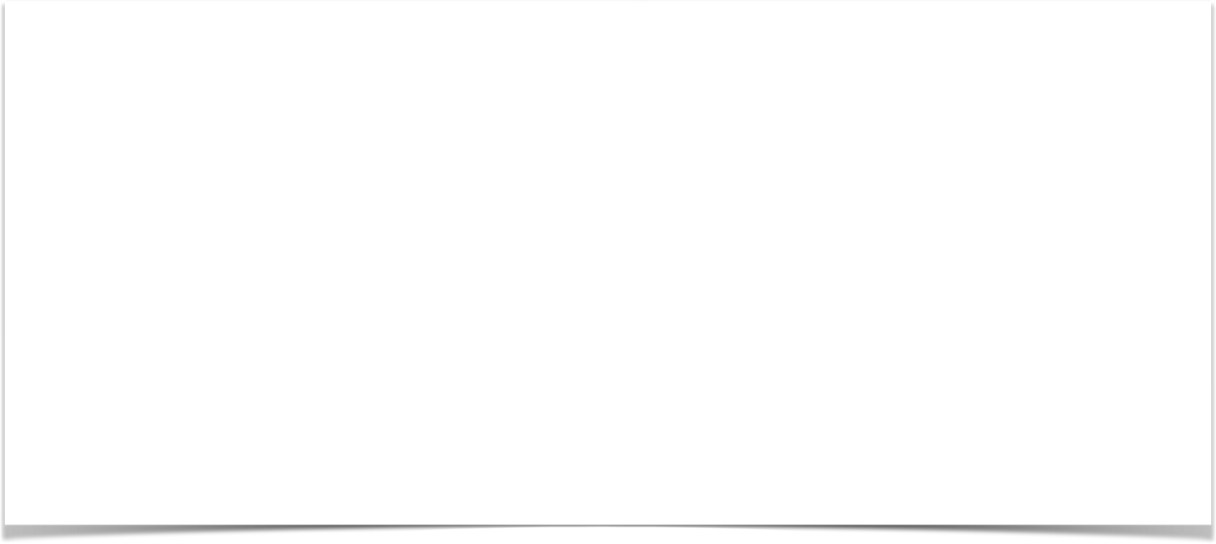

Step 2: Set up URL mappings to Spring MVC Dispatcher Servlet
File: web.xml
<web-app>
<servlet>
<servlet-name>dispatcher</servlet-name>
<servlet-class>org.springframework.web.servlet.DispatcherServlet</servlet-class>
...
</servlet>
<servlet-mapping>
<servlet-name>dispatcher</servlet-name>
<url-pattern>/</url-pattern>
</servlet-mapping>
</web-app>

Slide 21
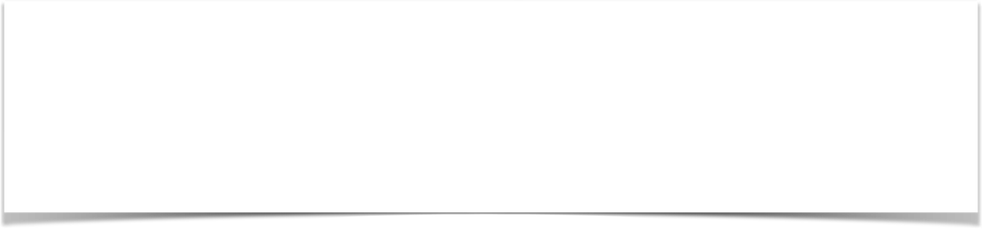
Step 3: Add support for Spring component scanning
File: spring-mvc-demo-servlet.xml
<beans>
<!-- Step 3: Add support for component scanning -->
<context:component-scan base-package="com.luv2code.springdemo" />
</beans>

Slide 22
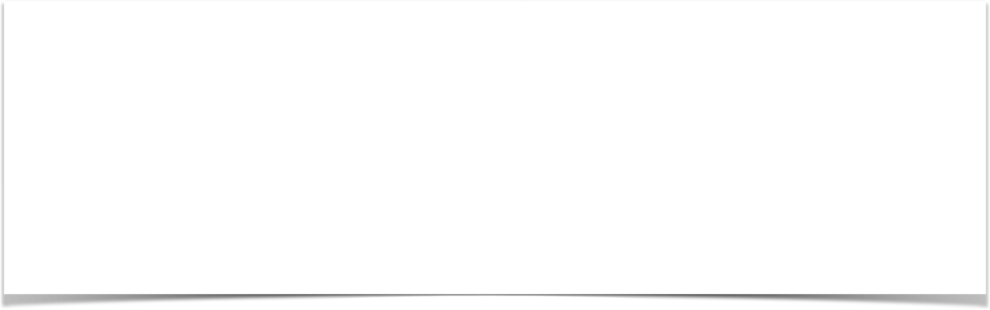
Step 4: Add support for conversion, formatting and validation
File: spring-mvc-demo-servlet.xml
<beans>
<!-- Step 3: Add support for component scanning -->
<context:component-scan base-package="com.luv2code.springdemo" />
<!-- Step 4: Add support for conversion, formatting and validation support -->
<mvc:annotation-driven/>
</beans>

Slide 23
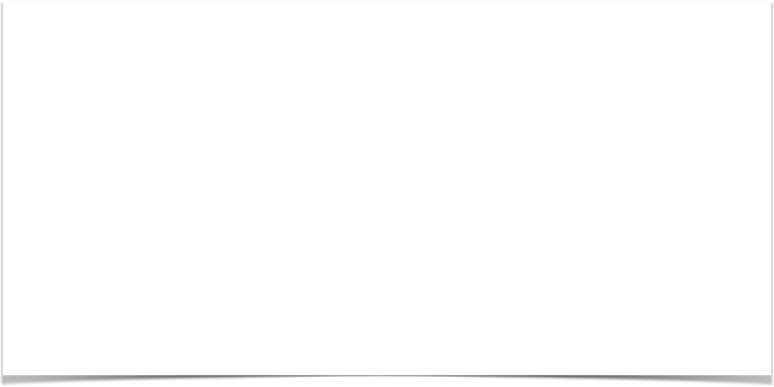
Step 5: Configure Spring MVC View Resolver
File: spring-mvc-demo-servlet.xml
<beans>
<!-- Step 3: Add support for component scanning -->
<context:component-scan base-package="com.luv2code.springdemo" />
<!-- Step 4: Add support for conversion, formatting and validation support -->
<mvc:annotation-driven/>
<!-- Step 5: Define Spring MVC view resolver -->
<bean
class="org.springframework.web.servlet.view.InternalResourceViewResolver">
<property name="prefix" value="/WEB-INF/view/" />
<property name="suffix" value=".jsp" />
</bean>
</beans>

Slide 24
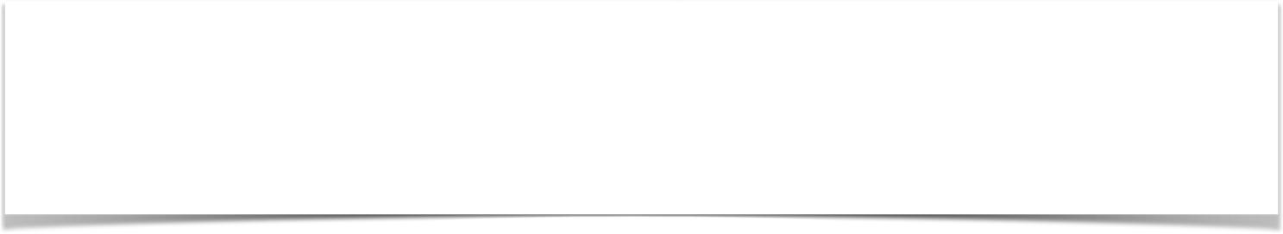
View Resolver Configs - Explained
When your app provides a “view” name, Spring MVC will
prepend the prefix
append the suffix
<bean
class="org.springframework.web.servlet.view.InternalResourceViewResolver">
<property name="prefix" value="/WEB-INF/view/" />
<property name="suffix" value=".jsp" />
</bean>

Slide 25

View Resolver Configs - Explained
<bean
class="org.springframework.web.servlet.view.InternalResourceViewResolver">
<property name="prefix" value="/WEB-INF/view/" />
<property name="suffix" value=".jsp" />
</bean>
/WEB-INF/view/
show-student-list
.jsp
View name

Slide 26
Developing
Spring Controllers and Views
Date

Slide 27
Model-View-Controller (MVC)

Slide 28



Our First Spring MVC Example
Request Path:
/
HomeController
main- menu.jsp

Slide 29
Development Process
Step-By-Step
Create Controller class
Define Controller method
Add Request Mapping to Controller method
Return View Name
Develop View Page

Slide 30

Step 1: Create Controller class
Annotate class with @Controller
@Controller inherits from @Component … supports scanning
@Controller
public class HomeController {
}

Slide 31
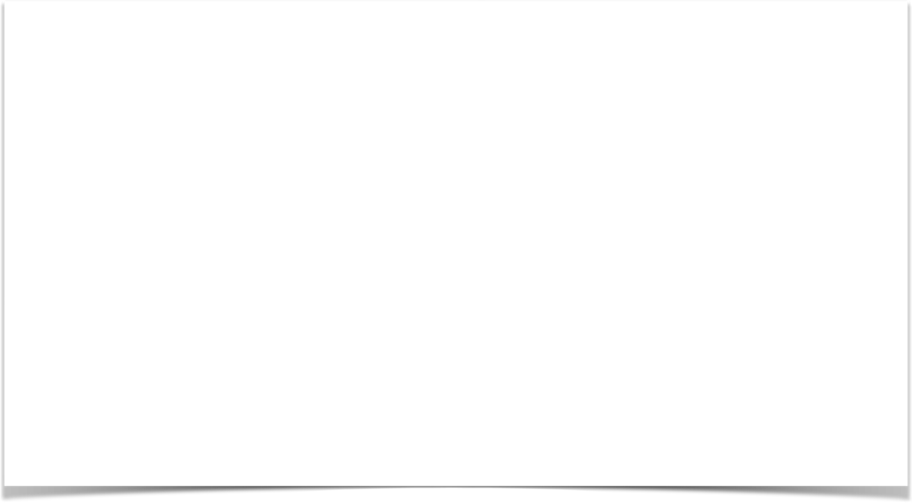
Step 2: Define Controller method
@Controller
public class HomeController {
public String showMyPage() {
…
}
}

Slide 32
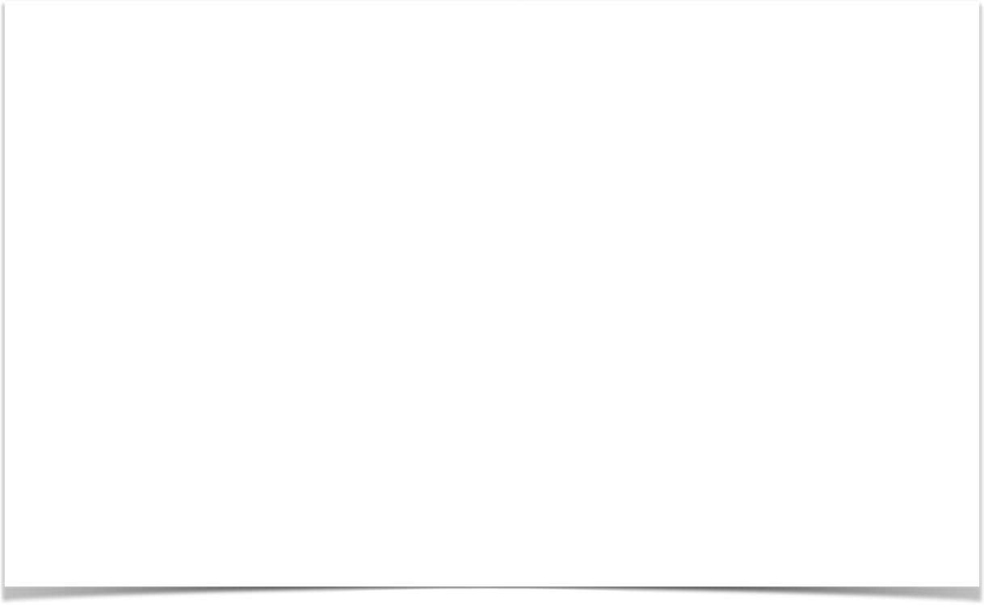
Step 3: Add Request Mapping to Controller method
@Controller
public class HomeController {
@RequestMapping("/") public String showMyPage() {
…
}
}

Slide 33
Step 4: Return View Name
@Controller
public class HomeController {
@RequestMapping("/")
public String showMyPage() {
return "main-menu";
}
}

Slide 34

Finding the View Page
<bean
class="org.springframework.web.servlet.view.InternalResourceViewResolver">
<property name="prefix" value="/WEB-INF/view/" />
<property name="suffix" value=".jsp" />
</bean>
/WEB-INF/view/main-menu.jsp
View name

Slide 35
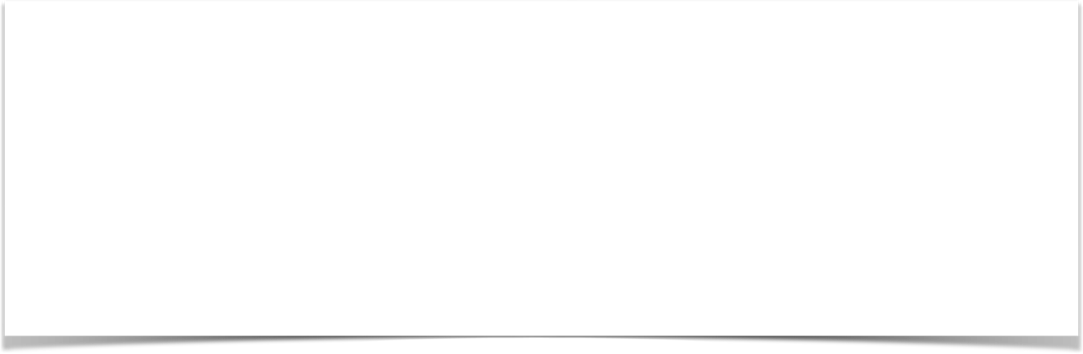
Step 5: Develop View Page
File: /WEB-INF/view/main-menu.jsp
<html><body>
<h2>Spring MVC Demo - Home Page</h2>
</body></html>

Slide 36
Recap - Development Process
Step-By-Step
Create Controller class
Define Controller method
Add Request Mapping to Controller method
Return View Name
Develop View Page
www.luv2code.com

Slide 37
Reading Form Data with Spring MVC
Date

Slide 38
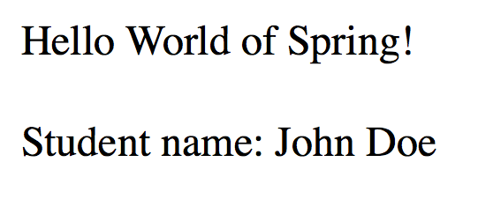
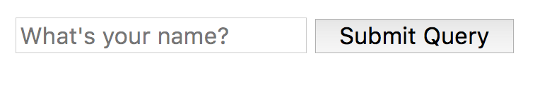

High Level View
helloworld.jsp
helloworld-form.jsp

Slide 39
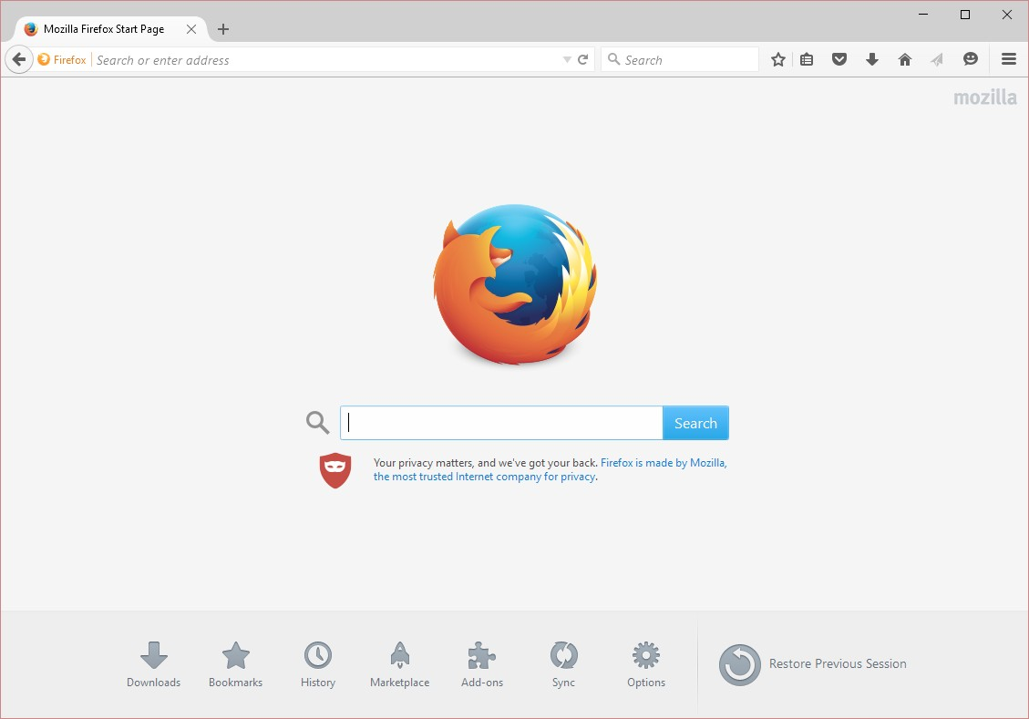



Application Flow
Request Mapping
helloworld-form.jsp
/showForm
HelloWorld Controller

Slide 40


Application Flow
Request Mapping
helloworld-form.jsp
/showForm
HelloWorld Controller
Request Mapping
/processForm
helloworld.jsp
helloworld-form.jsp
HelloWorld Controller

Slide 41
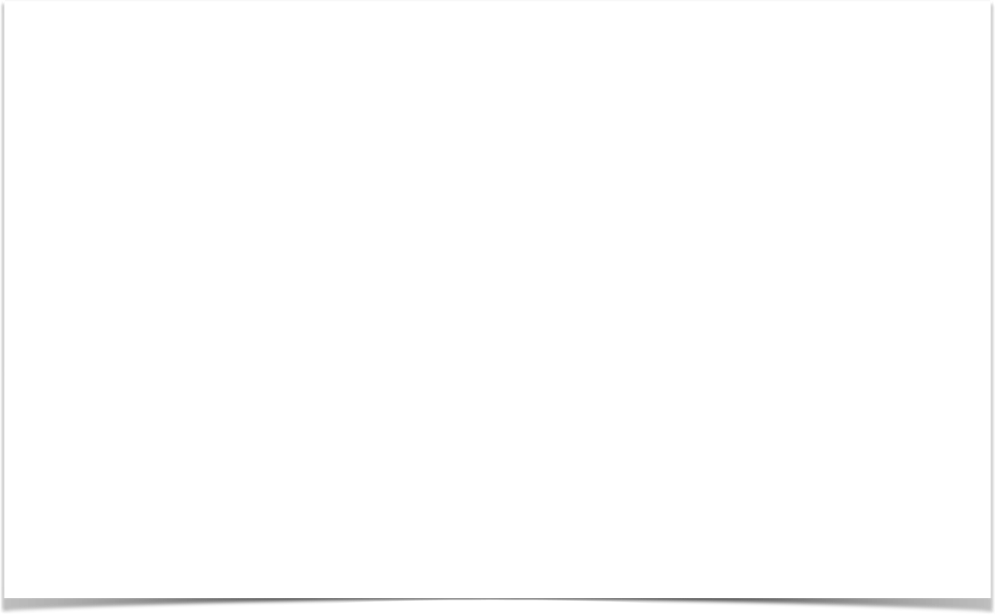
Controller Class
@Controller
public class HelloWorldController {
// need a controller method to show the initial HTML form @RequestMapping("/showForm")
public String showForm() { return "helloworld-form";
}
// need a controller method to process the HTML form @RequestMapping("/processForm")
public String processForm() { return "helloworld";
}
}

Slide 42
Development Process
Step-By-Step
Create Controller class
Show HTML form
Create controller method to show HTML Form
Create View Page for HTML form
Process HTML Form
Create controller method to process HTML Form
Develop View Page for Confirmation

Slide 43
Adding Data to Spring Model
Date

Slide 44
Focus on the Model

Slide 45

Spring Model
The Model is a container for your application data
•
In your Controller
You can put anything in the model
strings, objects, info from database, etc…
•
Your View page (JSP) can access data from the model

Slide 46
Code Example
•
We want to create a new method to process form data
•
Read the form data: student’s name
•
Convert the name to upper case
•
Add the uppercase version to the model

Slide 47
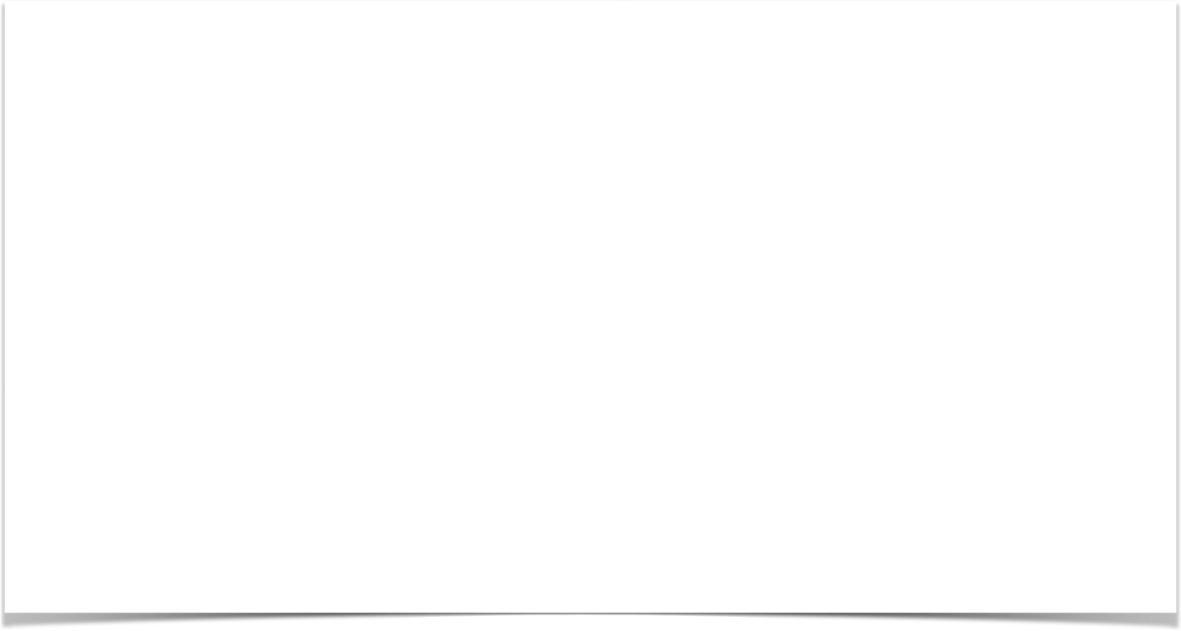
Passing Model to your Controller
@RequestMapping("/processFormVersionTwo")
public String letsShoutDude(HttpServletRequest request, Model model) {
// read the request parameter from the HTML form
String theName = request.getParameter("studentName");
// convert the data to all caps theName = theName.toUpperCase();
// create the message
String result = "Yo! " + theName;
// add message to the model model.addAttribute("message", result);
return "helloworld";
}

Slide 48
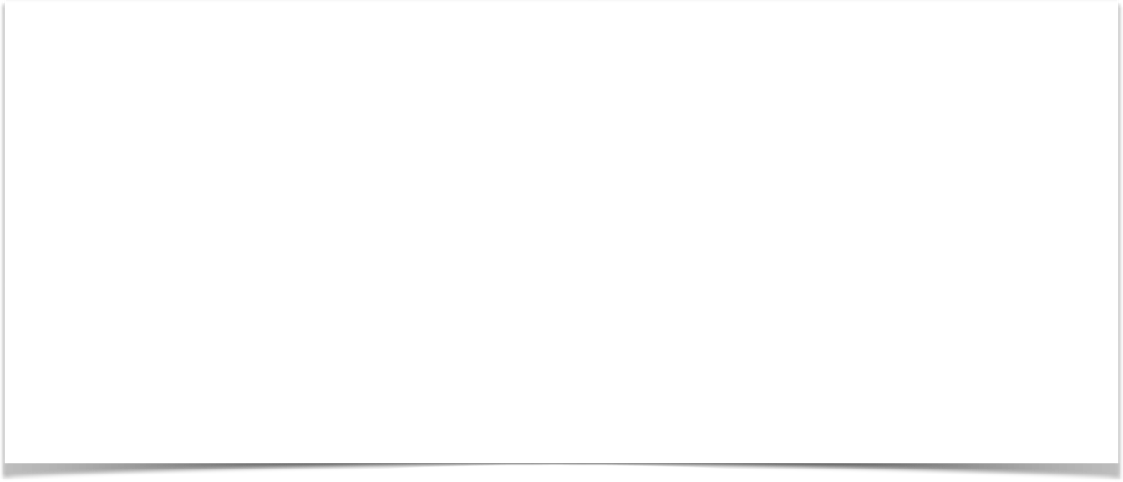
View Template - JSP
<html><body>
Hello World of Spring!
...
The message: ${message}
</body></html>

Slide 49
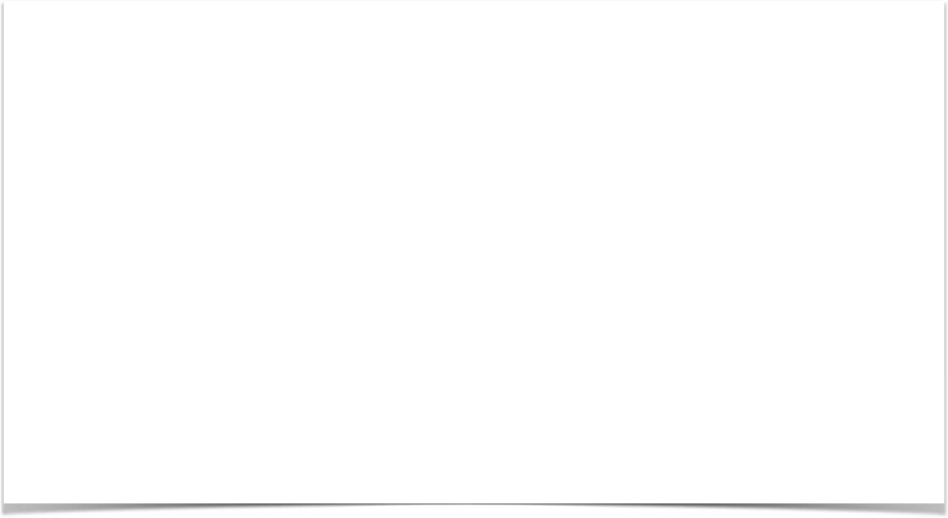
Adding more data to your Model
// get the data
//
String result = …
List<Student> theStudentList = … ShoppingCart theShoppingCart = …
// add data to the model
//
model.addAttribute("message", result);
model.addAttribute("students", theStudentList); model.addAttribute("shoppingCart", theShoppingCart);

Slide 50
Reading HTML Form Data with @RequestParam Annotation
Date

Slide 51
Code Example
•
We want to create a new method to process form data
•
Read the form data: student’s name
•
Convert the name to upper case
•
Add the uppercase version to the model

Slide 52
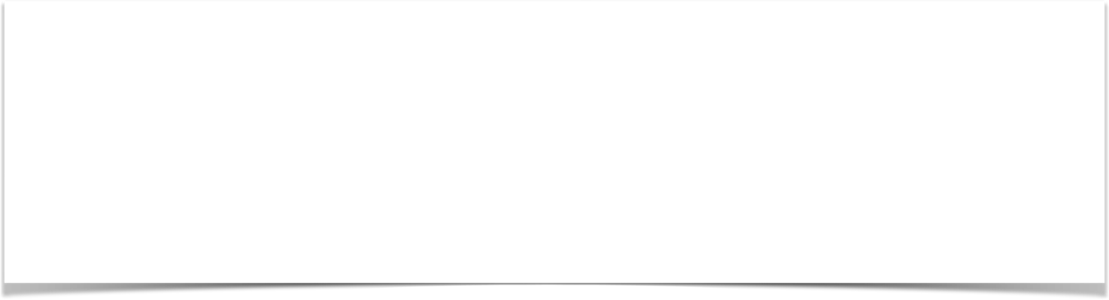
Instead of using HttpServletRequest
@RequestMapping("/processFormVersionTwo")
public String letsShoutDude(HttpServletRequest request, Model model) {
// read the request parameter from the HTML form
String theName = request.getParameter("studentName");
…
}

Slide 53

Bind variable using @RequestParam Annotation
@RequestMapping("/processFormVersionTwo")
public String letsShoutDude( @RequestParam("studentName") String theName, Model model) {
// now we can use the variable: theName
}
Behind the scenes:
Spring will read param from request: studentName Bind it to the variable: theName

Slide 54
Add Controller @RequestMapping
Date

Slide 55

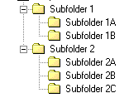
Adding Request Mappings to Controller
•
Serves as parent mapping for controller
•
All request mappings on methods in the controller are relative
•
Similar to folder directory structures

Slide 56
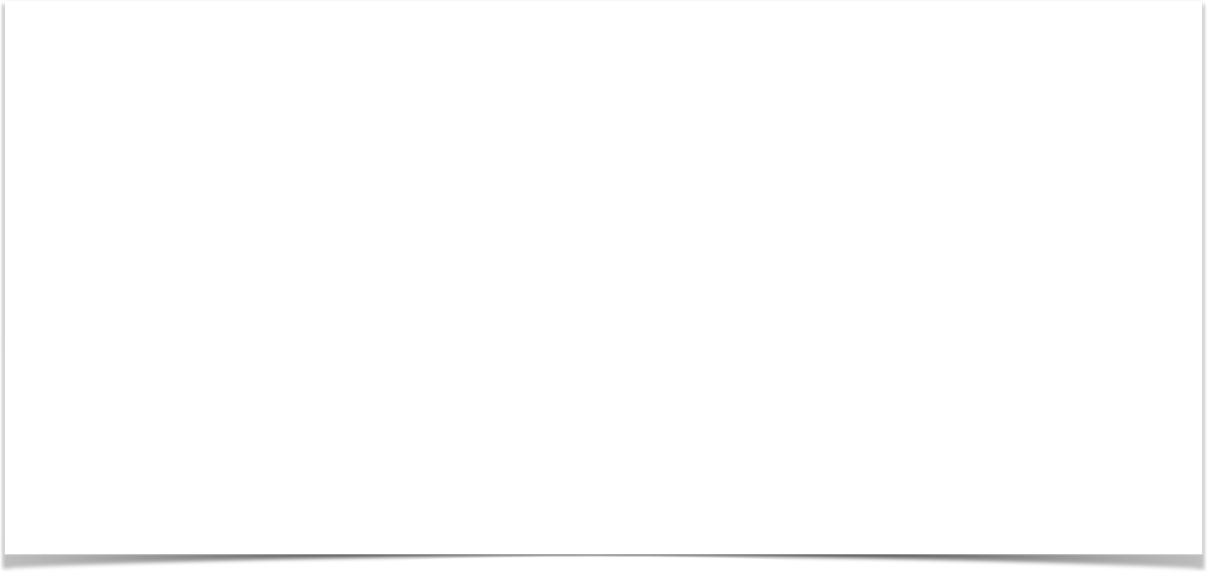


Controller Request Mapping
@RequestMapping("/funny") public class FunnyController {
@RequestMapping("/showForm") public String showForm() {
...
}
/funny/showForm
/funny/processForm
@RequestMapping("/processForm")
public String process(HttpServletRequest request, Model model) {
...
}
}

Slide 57
Spring MVC Form Tags

Slide 58
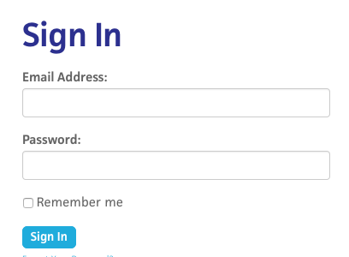
Review HTML Forms
•
HTML Forms are used to get input from the user

Slide 59
Spring MVC Form Tags
•
Spring MVC Form Tags are the building block for a web page
•
Form Tags are configurable and reusable for a web page

Slide 60
Data Binding
•
Spring MVC Form Tags can make use of data binding
•
Automatically setting / retrieving data from a Java object / bean

Slide 61













Spring MVC Form Tags
Form tags will generate HTML for you :-)
Form Tag Description
form:form | main form container
form:input | text field
form:textarea | multi-line text field
form:checkbox | check box
form:radiobutton | radio buttons
form:select | drop down list
more ….

Slide 62
Web Page Structure
•
JSP page with special Spring MVC Form tags
<html>
… regular html …
… Spring MVC form tags …
… more html …
</html>

Slide 63

How To Reference Spring MVC Form Tags
Specify the Spring namespace at beginning of JSP file
<%@ taglib prefix="form" uri="http://www.springframework.org/tags/form" %>

Slide 64
Spring MVC Form Tag - Text Field

Slide 65


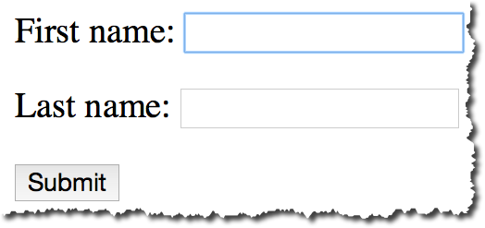


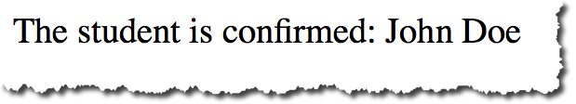
Big Picture
student-form.jsp
Student
Student Controller
Student
student-confirmation.jsp

Slide 66
Showing Form
In your Spring Controller
•
Before you show the form, you must add a model attribute
•
This is a bean that will hold form data for the data binding

Slide 67
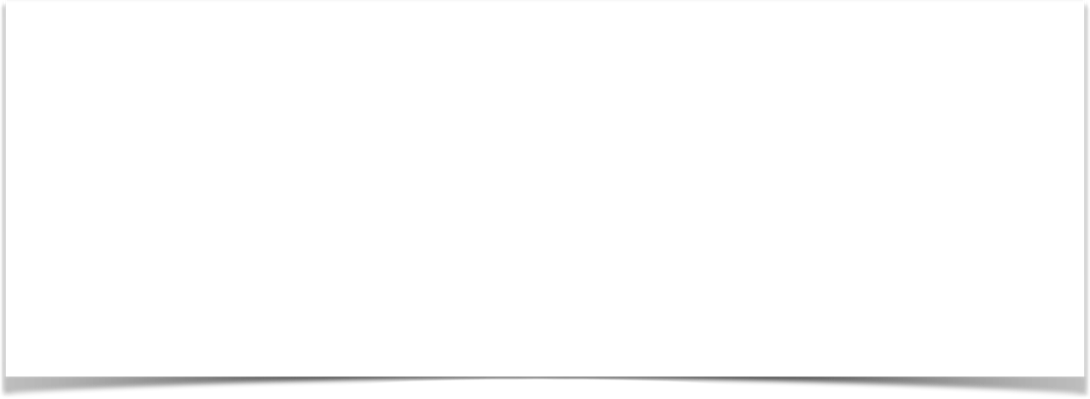
Show Form - Add Model Attribute
Code snippet from Controller
@RequestMapping("/showForm")
public String showForm(Model theModel) {
theModel.addAttribute("student", new Student()); return "student-form";
}

Slide 68
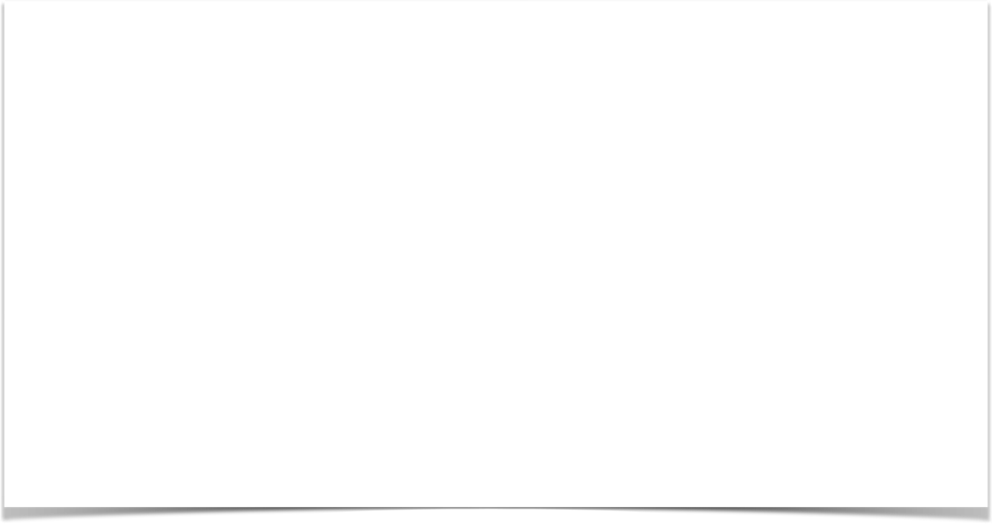

Setting up HTML Form - Data Binding
<form:form action="processForm" modelAttribute="student">
First name: <form:input path="firstName" />
<br><br>
Last name: <form:input path="lastName" />
<br><br>
<input type="submit" value="Submit" />
</form:form>

Slide 69


When Form is Loaded … fields are populated
<form:form action="processForm" modelAttribute="student">
First name: <form:input path="firstName" />
When form is loaded, Spring MVC will call:
<br><br>
Last name: <form:input path="lastName" />
student.getFirstName()
…
<br><br>
student.getLastName
<input type="submit" value="Submit" />
</form:form>

Slide 70


When Form is submitted … calls setter methods
<form:form action="processForm" modelAttribute="student">
First name: <form:input path="firstName" />
When form is submitted, Spring MVC will call:
<br><br>
Last name: <form:input path="lastName" />
student.setFirstName(…)
…
<br><br>
student.setLastName(…)
<input type="submit" value="Submit" />
</form:form>

Slide 71
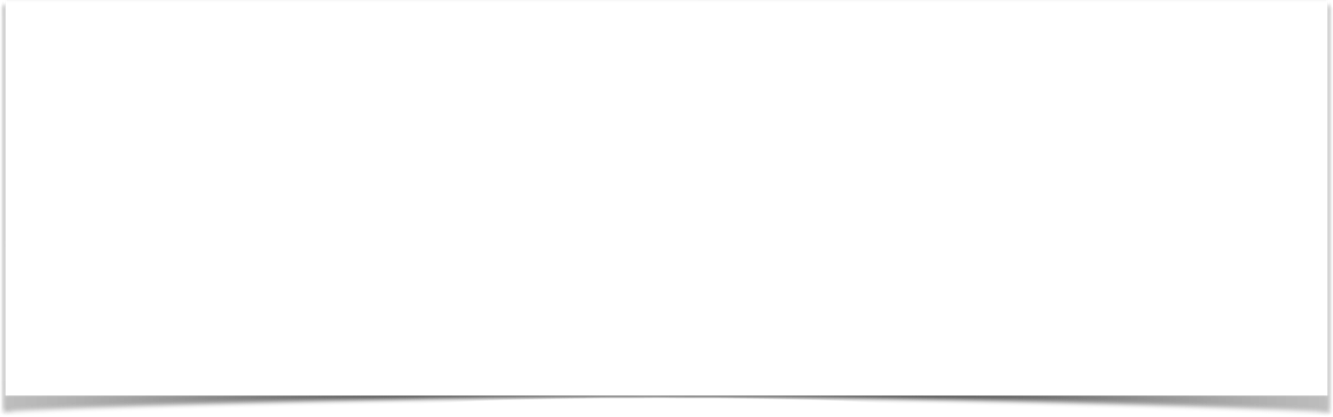
Handling Form Submission in the Controller
Code snippet from Controller
@RequestMapping("/processForm")
public String processForm(@ModelAttribute("student") Student theStudent) {
// log the input data
System.out.println("theStudent: " + theStudent.getFirstName()
+ " " + theStudent.getLastName());
return "student-confirmation";
}

Slide 72


Confirmation page
<html>
<body>
The student is confirmed: ${student.firstName} ${student.lastName}
</body>
</html>

Slide 73
Pulling It All Together
student-form.jsp
Student
Student Controller
Student
student-confirmation.jsp

Slide 74
Development Process
Step-By-Step
Create Student class
Create Student controller class
Create HTML form
Create form processing code
Create confirmation page

Slide 75
Spring MVC Form Tag - Drop Down List

Slide 76


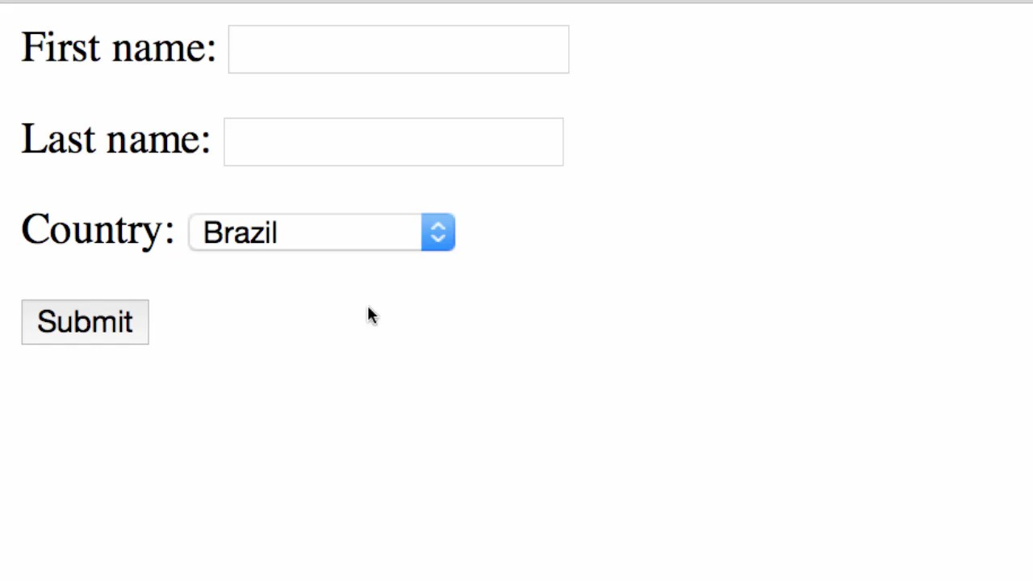
Review of HTML <select> Tag
<select name=“country”>
<option>Brazil</option>
<option>France</option>
<option>Germany</option>
<option>India</option>
...
</select>

Slide 77
Spring MVC Tag
Drop-Down List is represented by the tag
<form:select>

Slide 78
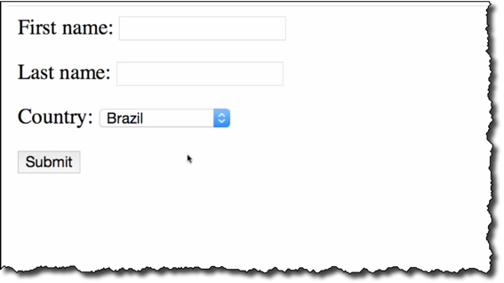
Code Snippet
<form:select path="country">
<form:option value="Brazil" label="Brazil" />
<form:option value="France" label="France" />
<form:option value="Germany" label="Germany" />
<form:option value="India" label="India" />
</form:select>

Slide 79




Pulling It All Together
student-form.jsp
Student
student form
Student Controller
Student
student-confirmation.jsp
confirmation page

Slide 80
Development Process
Step-By-Step
Update HTML form
Update Student class - add getter/setter for new property
Update confirmation page

Slide 81
Spring MVC Form Tag - Check Box

Slide 82
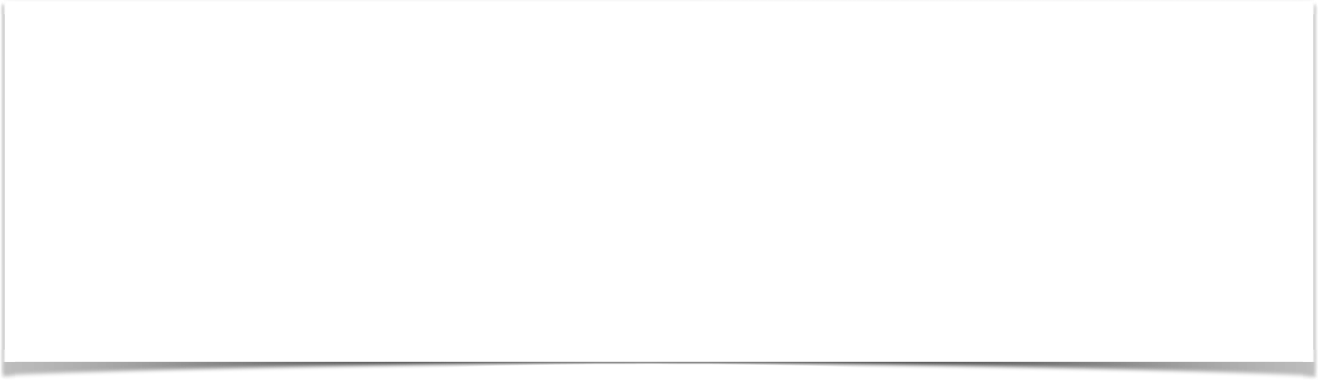
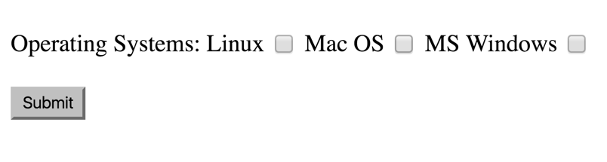
Check Box - Pick Your Favorite OS

Slide 83
Spring MVC Tag
A Check Box is represented by the tag
<form:checkbox>

Slide 84
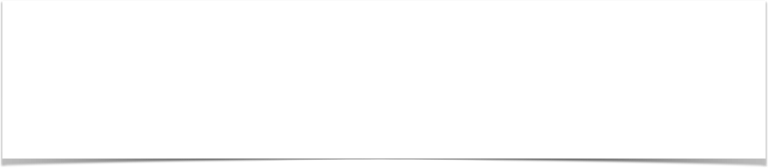
Code Example
Linux <form:checkbox path="operatingSystems" value="Linux" /> Mac OS <form:checkbox path="operatingSystems" value="Mac OS" /> MS Windows <form:checkbox path="operatingSystems"
value="MS Windows" />

Slide 85
Pulling It All Together
student-form.jsp
Student
student form
Student Controller
Student
student-confirmation.jsp
confirmation page

Slide 86
Development Process
Step-By-Step
Update HTML form
Update Student class - add getter/setter for new property
Update confirmation page

Slide 87

Spring MVC Form Validation

Slide 88
The Need for Validation
Check the user input form for
required fields valid numbers in a range valid format (postal code)
custom business rule

Slide 89
Java’s Standard Bean Validation API
•
Java has a standard Bean Validation API
•
Defines a metadata model and API for entity validation
•
Not tied to either the web tier or the persistence tier
•
Available for server-side apps and also client-side JavaFX/Swing apps

Slide 90
Spring and Validation
•
Spring version 4 and higher supports Bean Validation API
•
Preferred method for validation when building Spring apps
•
Simply add Validation JARs to our project

Slide 91





Bean Validation Features
Validation Feature
required
validate length
validate numbers
validate with regular expressions
custom validation

Slide 92








Validation Annotations
Annotation Description
@NotNull | Checks that the annotated value is not null
@Min | Must be a number >= value
@Max | Must be a number <= value
@Size | Size must match the given size
@Pattern | Must match a regular expression pattern
@Future / @Past | Date must be in future or past of given date
others …

Slide 93
Our Road Map
set up our development environment
required field
validate number range: min, max
validate using regular expression (regexp)
custom validation

Slide 94

Setting Up Development Environment

Slide 95

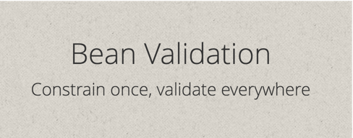
Java’s Standard Bean Validation API
•
Java’s standard Bean Validation API (JSR-303)
•
Only a specification … vendor independent … portable
•
BUT we still need an implementation …

Slide 96
The Hibernate Team to the rescue!
•
Hibernate started as an ORM project
•
But in recent years, they have expanded into other areas
•
They have a fully compliant JSR-303 implementation
•
Not tied to ORM or database work … separate project

Slide 97
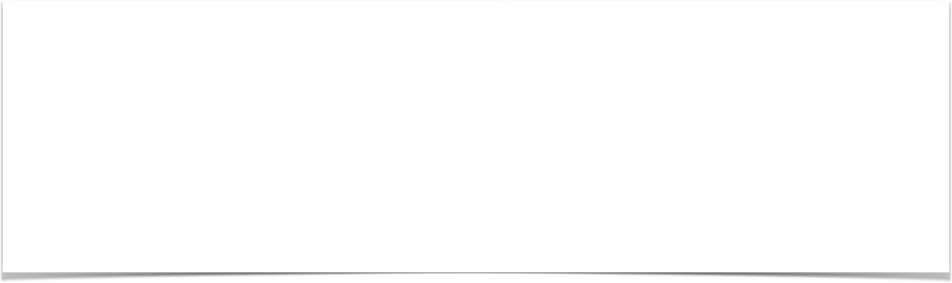
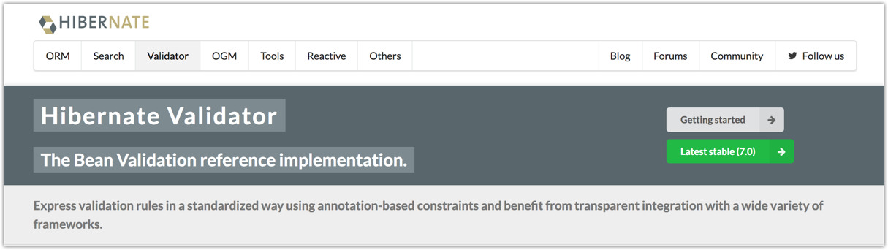
http://www.hibernate.org/validator

Slide 98
http://www.hibernate.org/validator

Slide 99
http://www.hibernate.org/validator

Slide 100
Hibernate Validator 7 is based on Jakarta EE 9
•
Spring 5 is still based on some components of Java EE (javax.*)
•
Spring may use Jakarta EE components in the future ... but no news yet
•
As a result, Spring 5 is not compatible with Hibernate Validator 7

Slide 101
But wait ... I need to use latest version!!!
Two releases of Hibernate Validator
Hibernate Valid tor 7 is for Jakart EE 9 projects Hibernate Validator 6 2 is compatible with Spring 5

Slide 102
But wait ... I need to use latest version!!!
Two releases of Hibernate Validator
Hibernate Validator 7 is for Jakarta EE 9 projects
Hibernate Validator 6.2 is compatible with Spring 5
•
Hibernate Validator 6.2 has the SAME features as Hibernate Validator 7
So you are not being left behind by using Hibernate Validator 6.2
Just tricky things with version numbers

Slide 103
More details on Hibernate Validator release
https://in.relation.to/hibernate-validator

Slide 104
Development Process
Step-By-Step
Download Validation JAR files from Hibernate Validator website
Add JAR files to project

